Slide 1
CAMPUS RECRUITMENT
Submitted as a part of the course
Information visualization
CSE-3044

Slide 2
ABSTRACT
Campus recruitment is a strategy for sourcing, engaging and hiring young talent for internship and entry-level positions. College recruiting is typically a tactic for medium- to large-sized companies with high-volume recruiting needs, but can range from small efforts (like working with university career centers to source potential candidates) to large-scale operations (like visiting a wide array of colleges and attending recruiting events throughout the spring and fall semester). Campus recruitment often involves working with university career services centers and attending career fairs to meet in-person with college students and recent graduates.

Slide 3
INTRODUCTION
This data set consists of Placement data of students . It includes secondary and higher secondary school percentage and specialization. It also includes degree specialization, type and Work experience and salary offers to the placed students.
Questions
Which factor influenced a candidate in getting placed?
Does percentage matters for one to get placed?
Which degree specialization is much demanded by corporate?
Does work experience matter for one to get placed?
Play with the data conducting all statistical tests.

Slide 4
In this project we are going to visualize the chances and possibility for a candidate getting placed in a company based on the factors given below:
1.Work experience
2.10th grade percentage
3.12th Grade percentage
4.Degree percentage
5.Gender
6.Field of Degree

Slide 5
TOOLS AND TECHNOLOGIES
Data visualization using Python 3 and kaggle notebook and tableau for basic visualizations
Data extraction: Kaggle
Data set used: https://www.kaggle.com/benroshan/factors-affecting-campus-placement

Slide 6
WORKFLOW
Data extraction, loading the data set
Understanding trends, outliers and patterns in the data
Feature classification, salary prediction
INPUT
PREPROCESSING
VISUALIZATION
MODEL
IMPLEMENTATION
OUTPUT
Data cleaning, Data integration, Data reduction, and Data transformation
Model planning, execution and prediction

Slide 7
GANTT CHART
ACTIVITY-1: Gathering data
ACTIVITY-2: Cleaning and Exploring data
ACTIVITY-3: Plotting each factor vs all factors
ACTIVITY-4: E-TEST Distribution
ACTIVITY-5: Distribution of all factors
ACTIVITY-6: Model implementation
ACTIVITY-7: PPT preparation, Conclusion

Slide 8
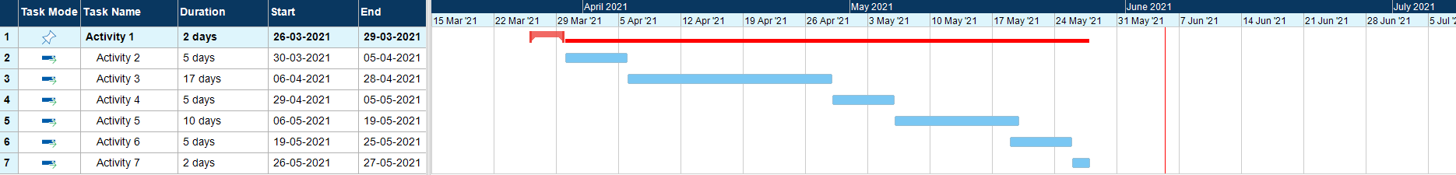
GANTT CHART

Slide 9
MODULE WISE
EXPLANATION
max growth

Slide 10
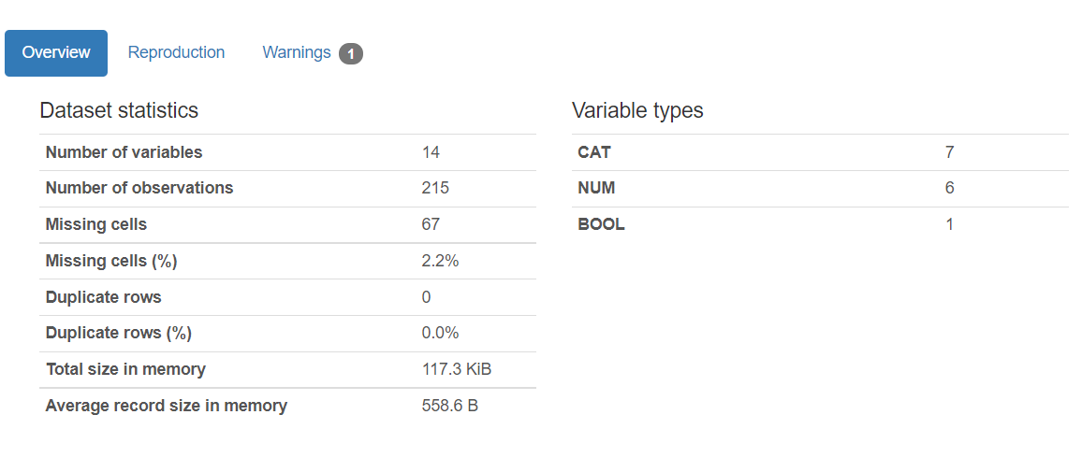
OVERVIEW OF THE DATASET

Slide 11
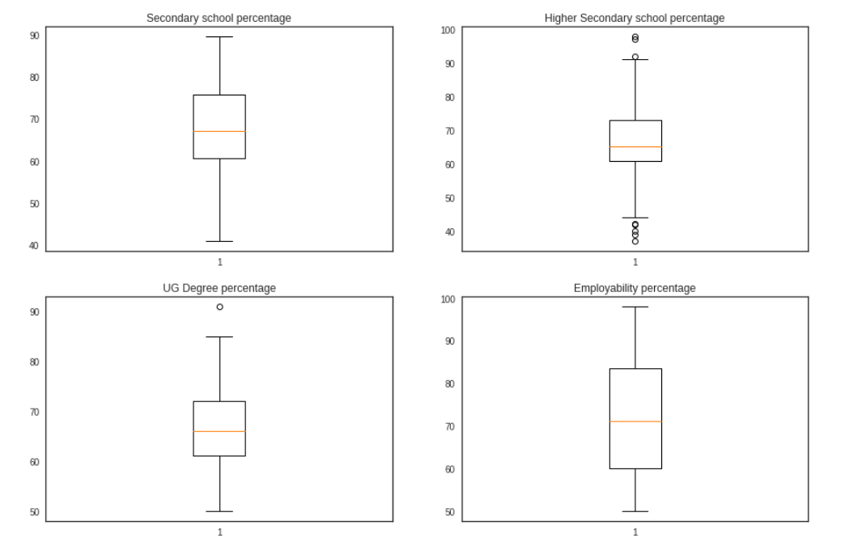
OUTLIER DETECTION

Slide 12
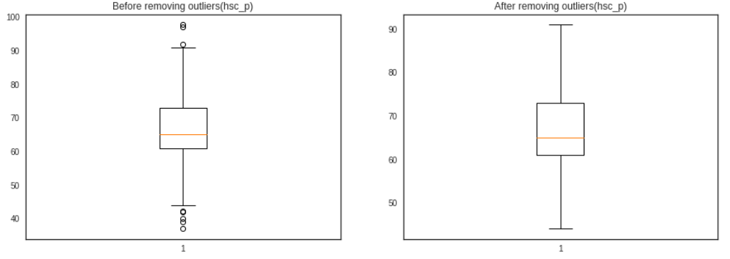

Slide 13
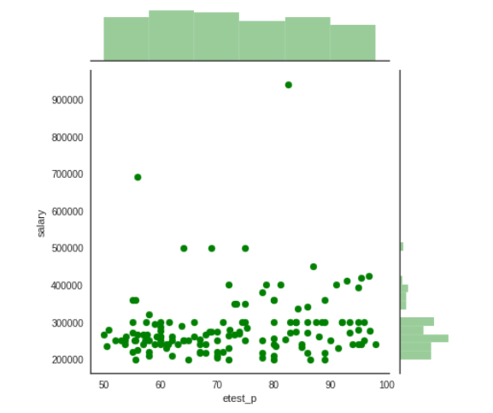
ETEST DISTRIBUTION

Slide 14
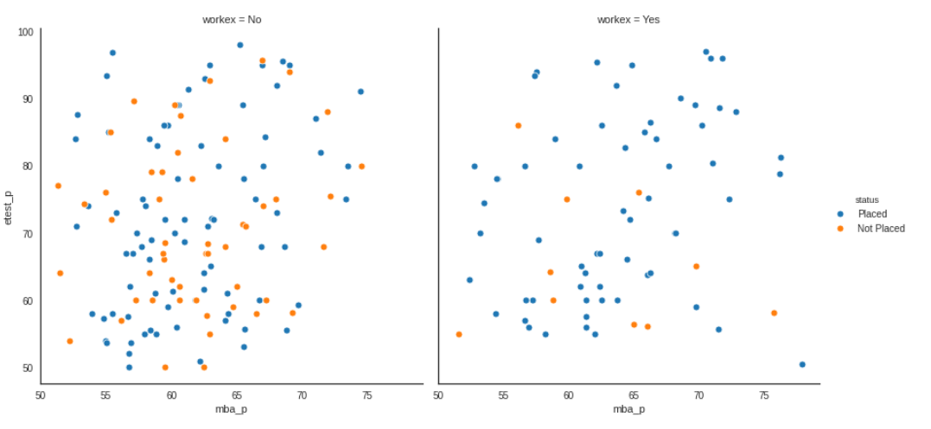

Slide 15
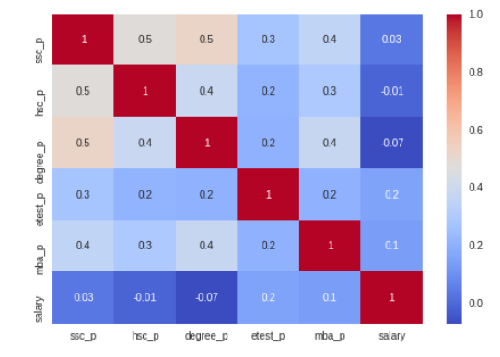
CORRELATION MATRIX

Slide 16
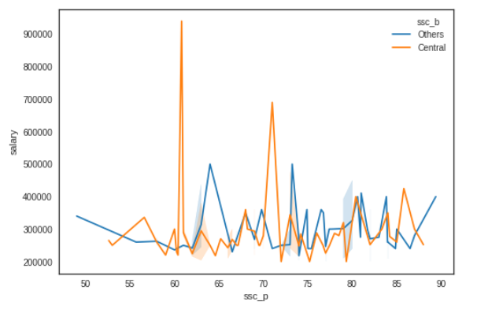
VISUALIZING INDIVIDUAL FEATURES

Slide 17
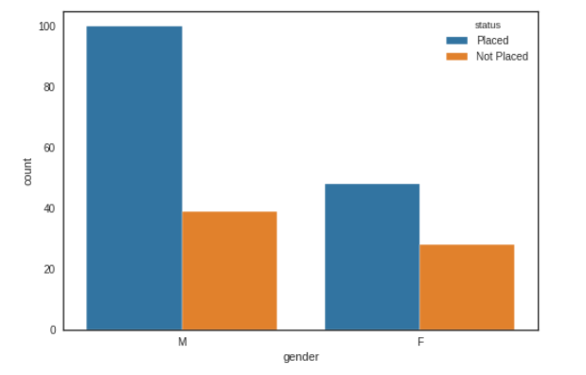
GENDER

Slide 18
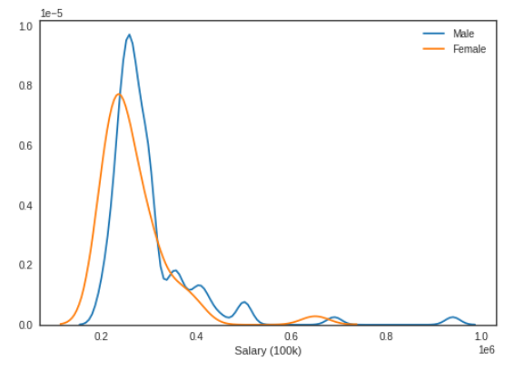
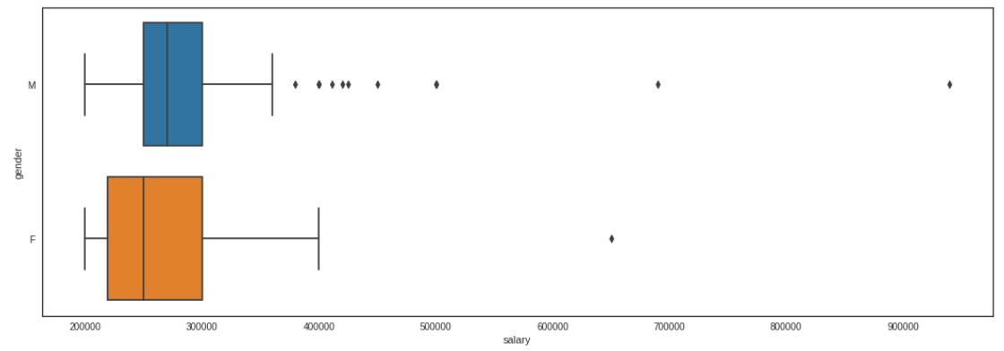

Slide 19
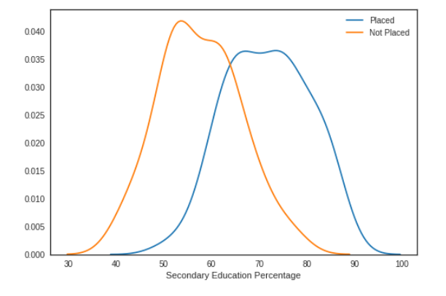
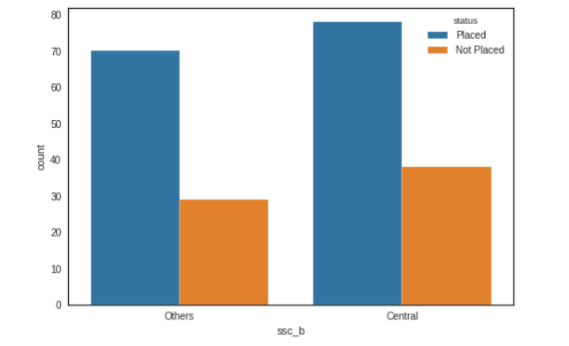
SCC PERCENTAGE, SSC BOARD

Slide 20
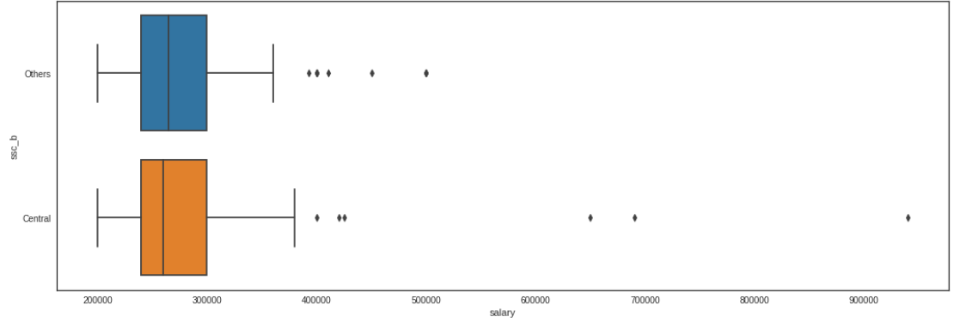

Slide 21
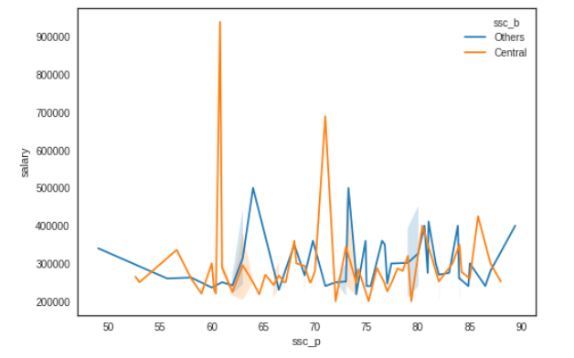

Slide 22
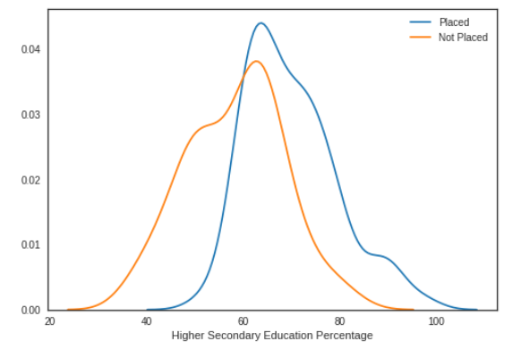
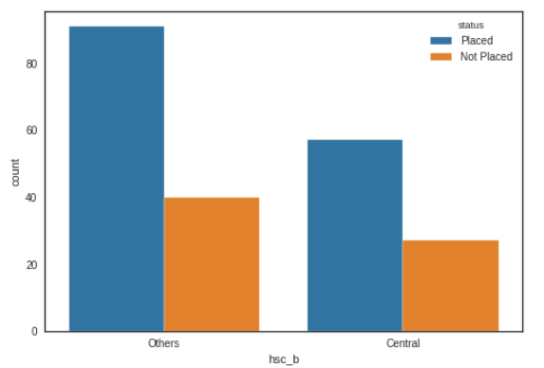
HSC PERCENTAGE, HSC BOARD, HSC SPECIALIZATION

Slide 23
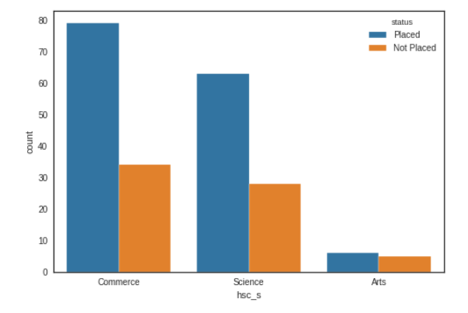
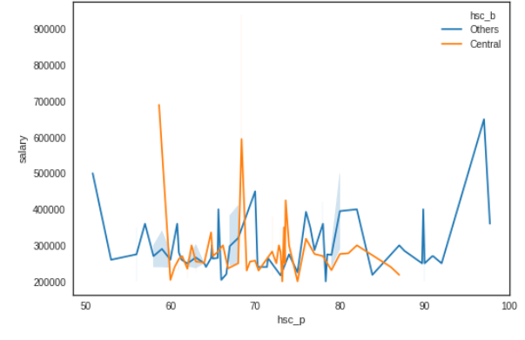

Slide 24
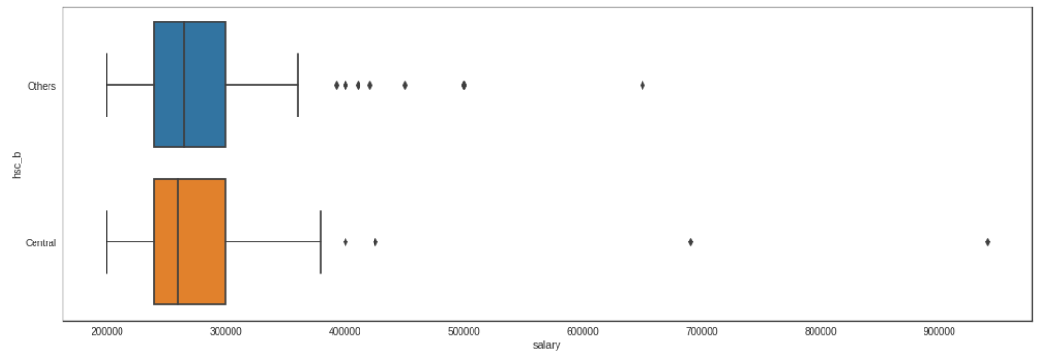

Slide 25
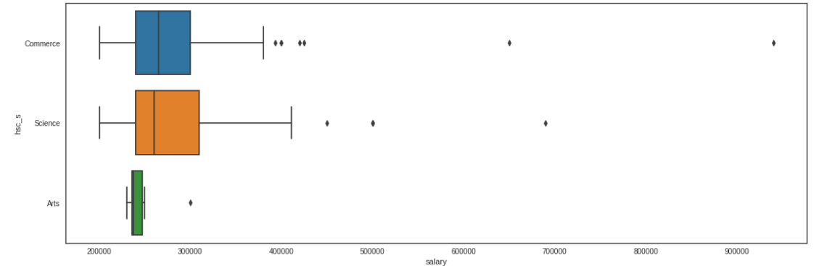

Slide 26
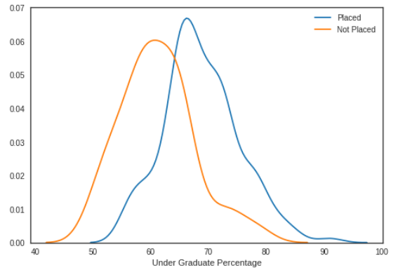
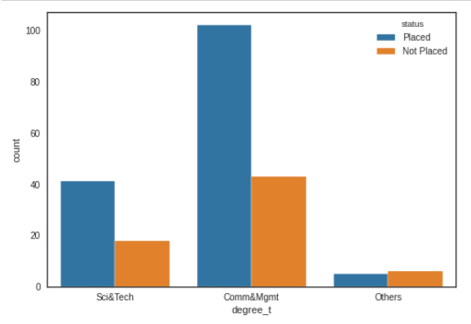
DEGREE PERCENTAGE, DEGREE FIELD

Slide 27
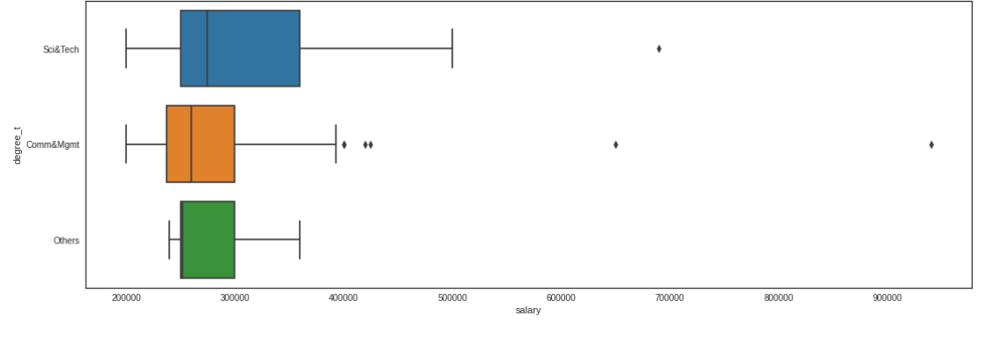
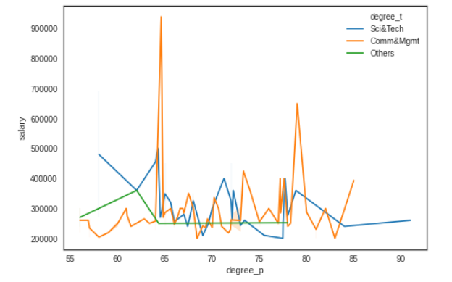

Slide 28
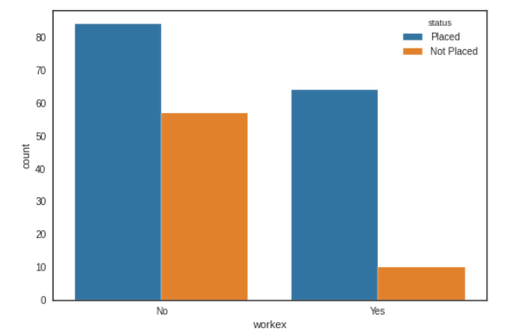
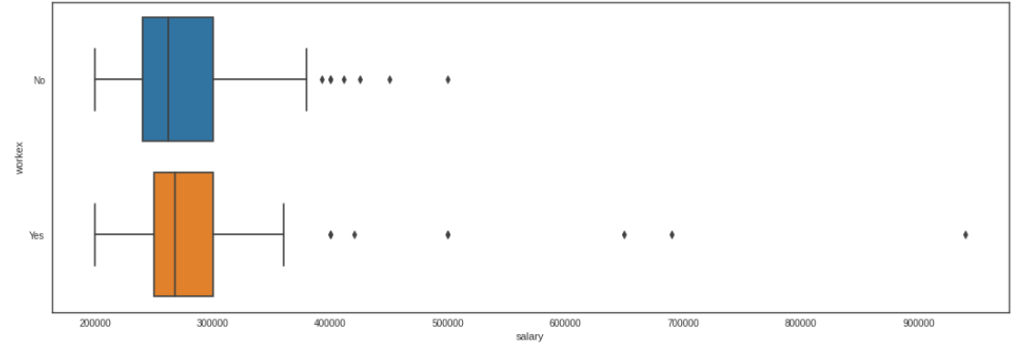
WORK EXPERIENCE

Slide 29
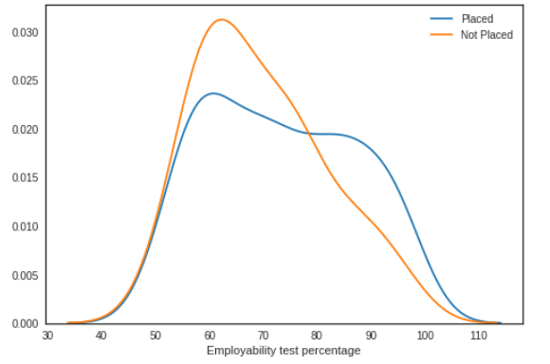
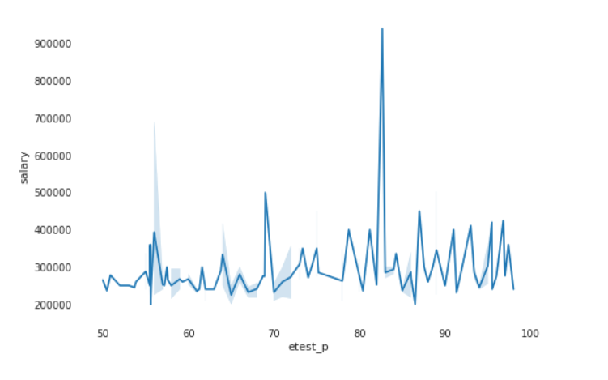
EMPLOYABILITY TEST PERCENTAGE

Slide 30
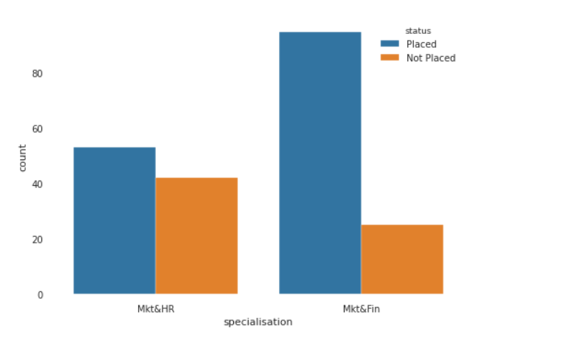
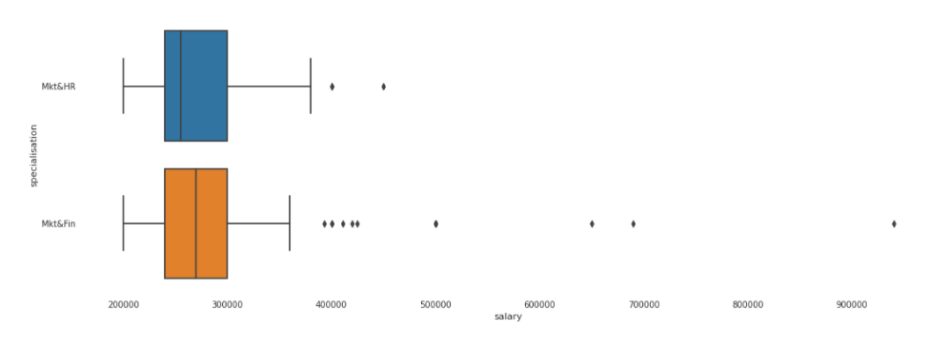
POST GRADUATE SPECIALIZATION

Slide 31
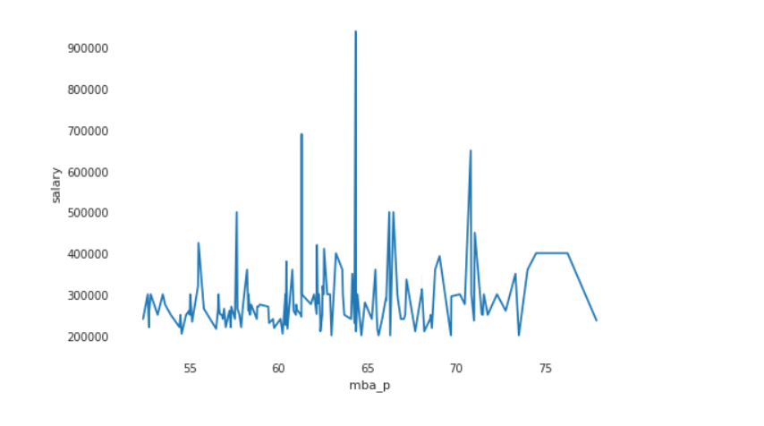
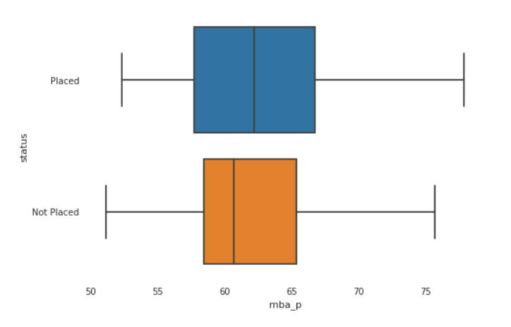
MBA PERCENTAGE

Slide 32
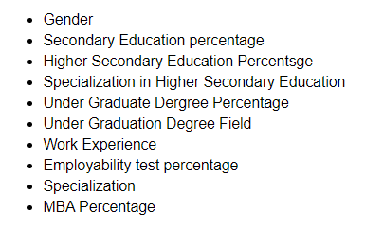
FEATURE SELECTION

Slide 33
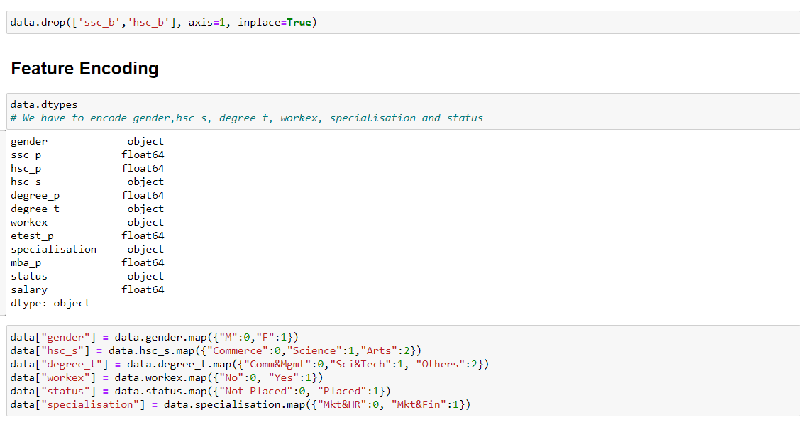
DATA PREPROCESSING

Slide 34
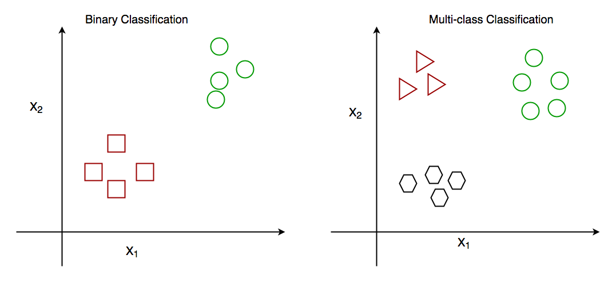
BINARY CLASSIFICATION PROBLEM

Slide 35
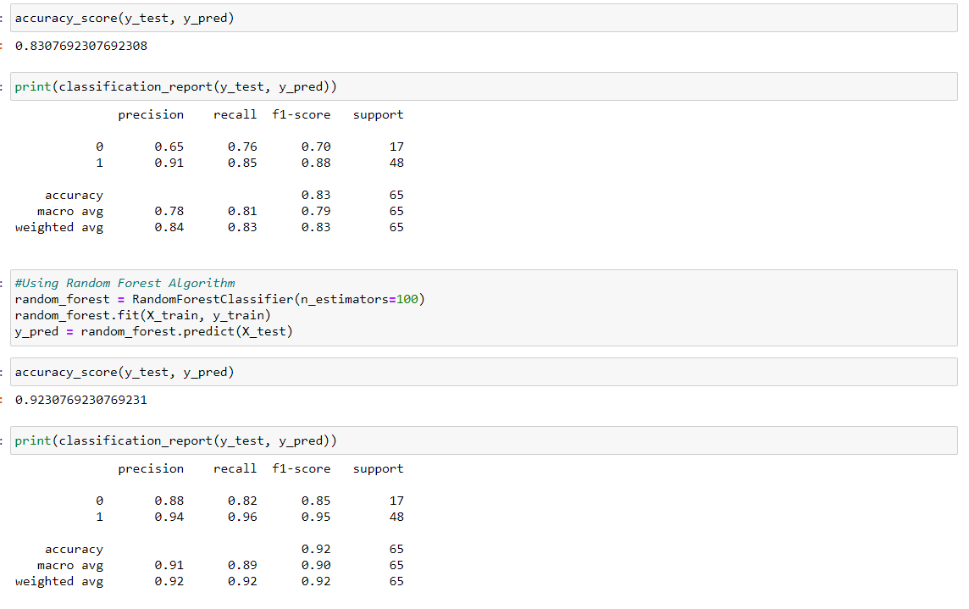
DECISION TREE CLASSIFIER

Slide 36
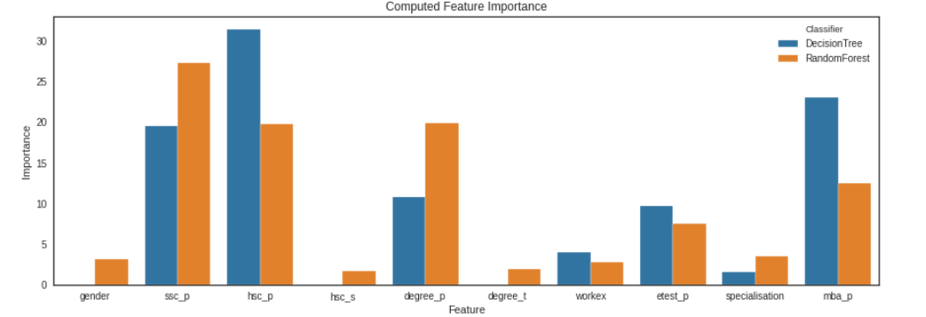

Slide 37
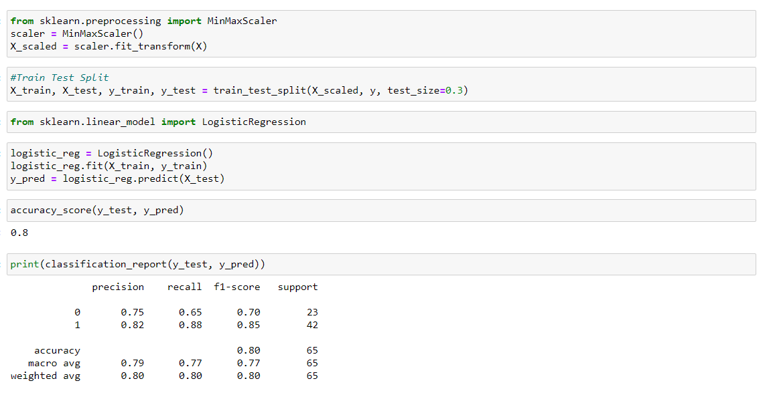
LOGISTIC REGRESSION

Slide 38
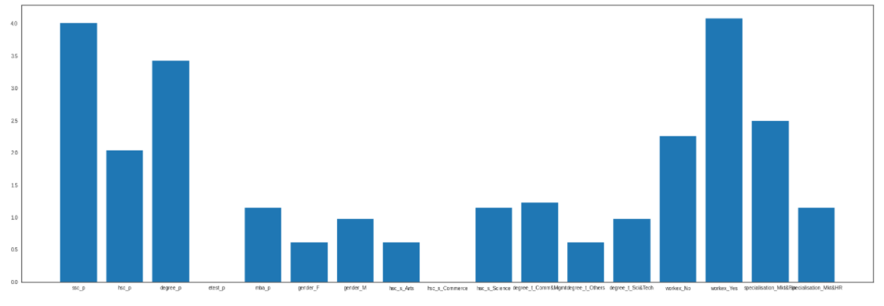

Slide 39
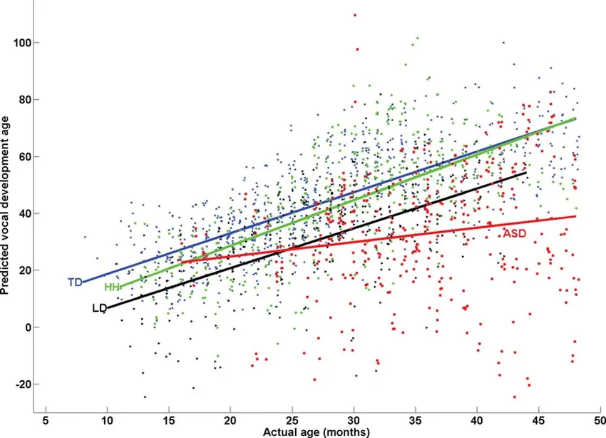
REGRESSION ANALYSIS

Slide 40
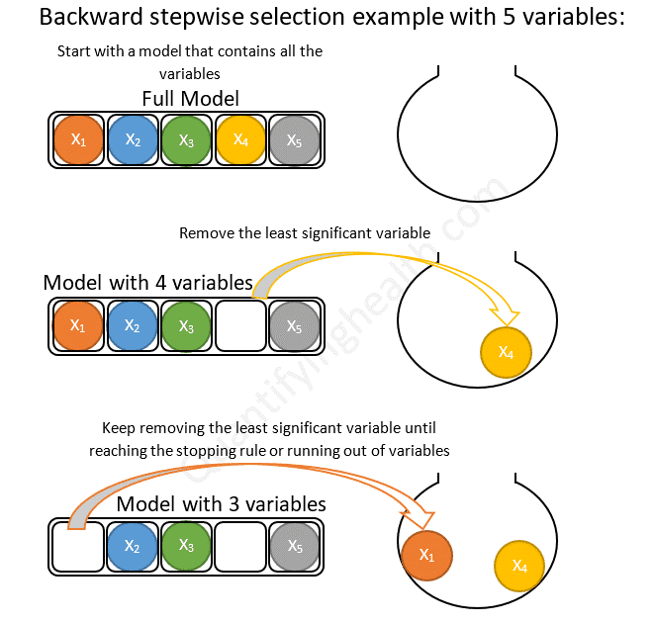
FEATURE SELECTION

Slide 41
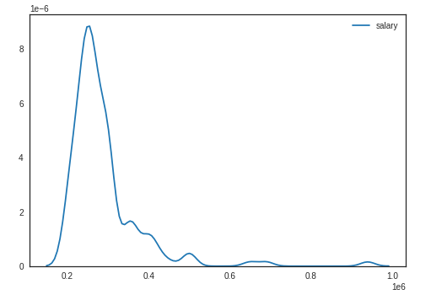
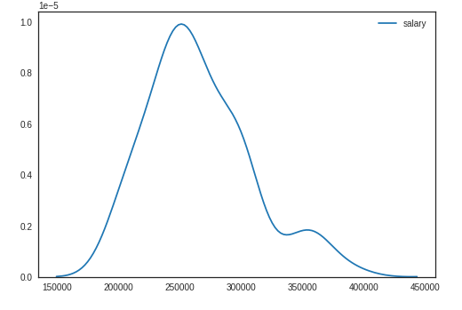

Slide 42
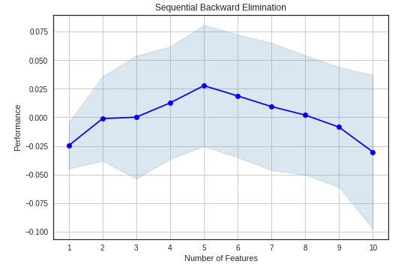
DETERMINING LEAST SIGNIFICANT VARIABLE

Slide 43
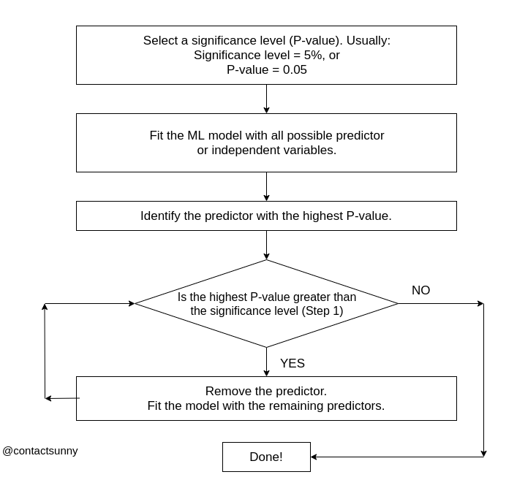

Slide 44
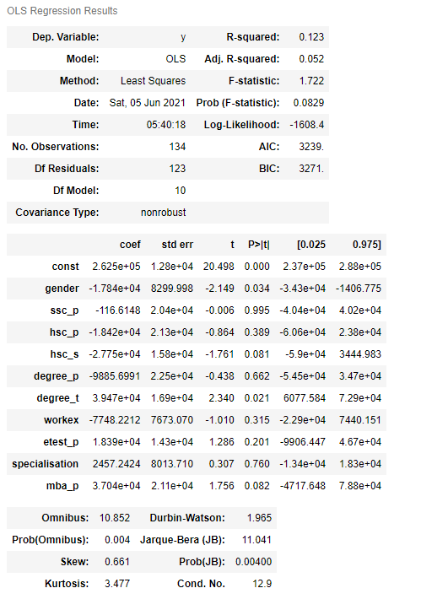
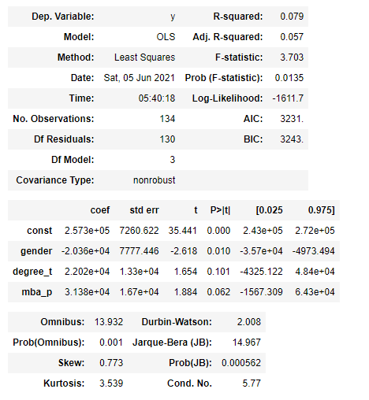
RESULT

Slide 45

OUTPUTS FROM TABLEAU

Slide 46
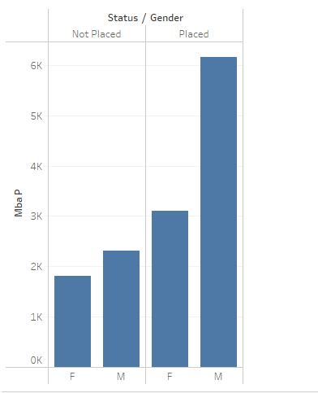
BAR GRAPH

Slide 47
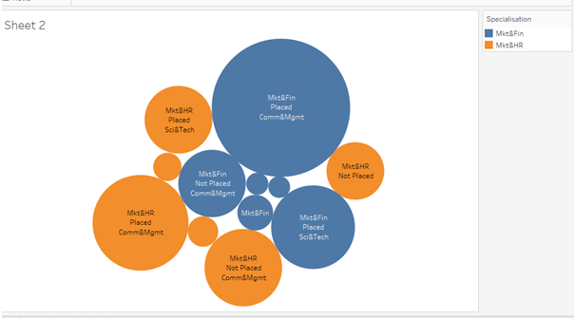
BUBBLE CHART

Slide 48

BAR GRAPH FOR SALARY VS GENDER/SPECIALIZATION/DEGREE OF FIELD

Slide 49

PIE CHART

Slide 50

BOX PLOT

Slide 51

K-MEANS CLUSTER CHART

Slide 52
CONCLUSION
From the machine learning models we identifies what are all the features that affects the salary
Therefore the top 5 feature that affects the salary are:
gender -> Gender
degree_t -> Under Graduation(Degree type)- Field of degree education
mba_p -> MBA percentage
hsc_s -> Specialization in Higher Secondary Education
etest_p -> Employability test percentage

Slide 53
THANK YOU

